Slide 1

Create your dream house

Slide 2






You will need:
white cardboard (70x50cm)
green cardboard (70x100 cm)
pencil
paint
paintbrushes
scissors
glue
magazines

Slide 3
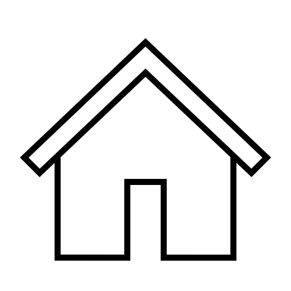
1. Draw a big house on the white cardboard

Slide 4
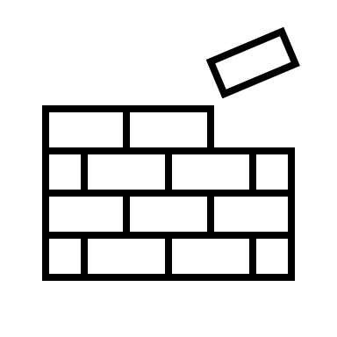
2. Decorate the walls and the roof with paint

Slide 5
3. Cut out the house

Slide 6
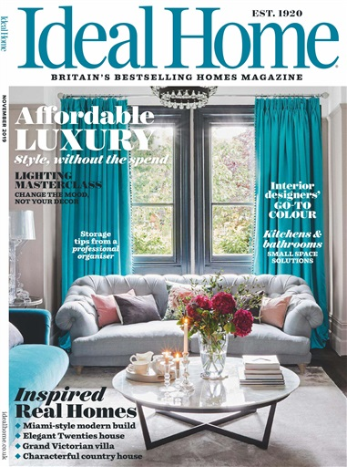

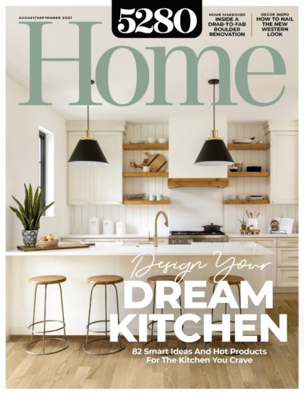
4. Find magazine pictures of a kitchen, a living room, a bedroom and a bathroom.

Slide 7
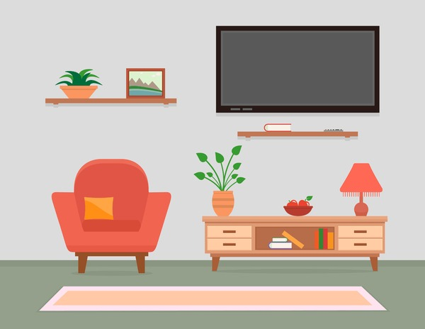
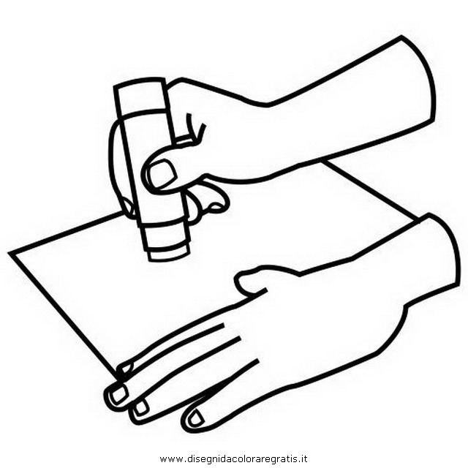
5. Glue the pictures onto the house

Slide 8

6. Glue the house onto the green cardboard.

Slide 9
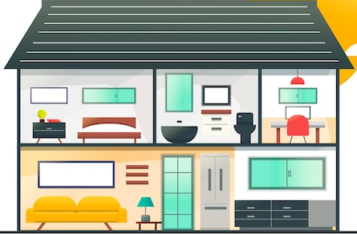
7. Draw a garden and decorate it

